Slide 1
Battle Cars: Mayhem & Destruction
Sleepless burrito
Slayers
Presents:
Team Members:
Andy Madruga – andym@fullsail.edu
Daniel Kahn –
Josh Fields – JFields1991@gmail.com
John Rostick –
Wade Shwallon –

Slide 2
Game Synopsis and wheel info
Sprint 1 – Feature Creep
Sprint 2 – Team Swap
Sprint 3 – Advertisement
Q & A - Disruption

Slide 3
Responsibilities
Andy Madruga
Particle Editor/Engine
Daniel Kahn
Art
John Rostick
AI
Josh Fields
Tile Editor/Engine
World Collision
Events & Messages
Wade Shwallon
Car Physics

Slide 4
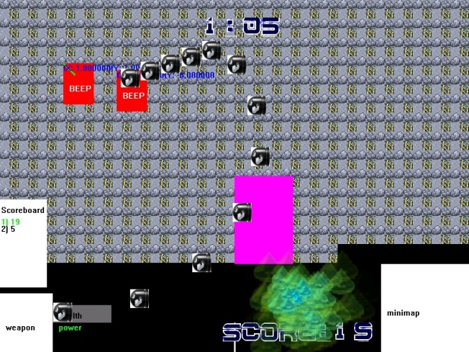
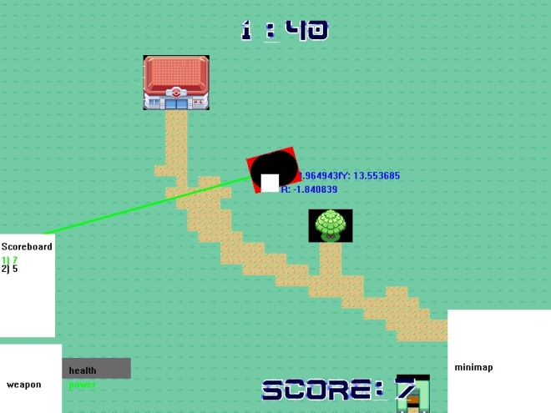
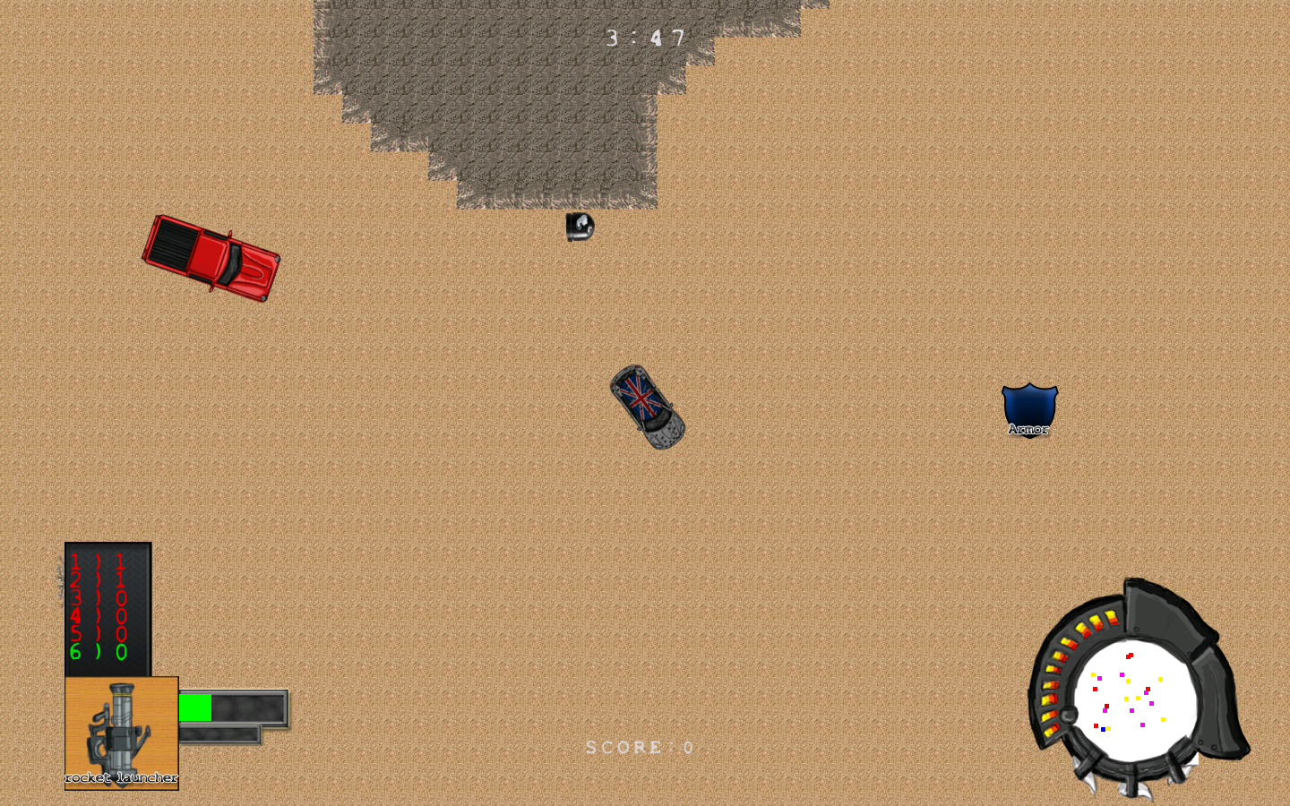
Game Progress Slide
Sprint 1
Sprint 2
Sprint 3

Slide 5
Tips and Tricks Slide
Talk to your team mates
Be aware of your limits and capabilities

Slide 6
What Went Right

Slide 7
What Went Wrong
Team Swap
Tile Editor
Collision Physics

